Slide 1
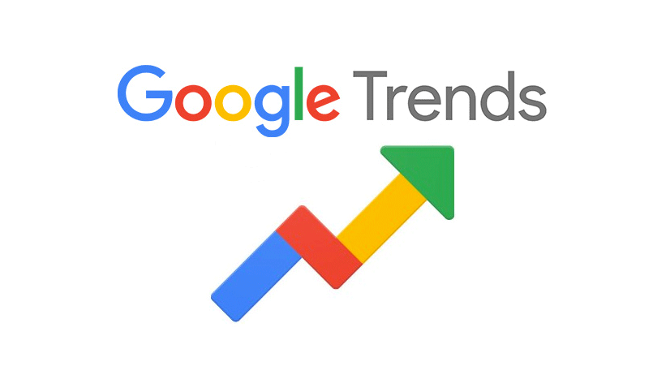
Examining the Predictive Power of Google Trends Data for Economic Indicators
Dehong Lu
MACS 30200
University of Chicago

Slide 2
Introduction
Google Trends measures the search volume of keywords on Google Search
A great tool to reveal the interests of the public
Google Trends as a public opinion survey tool
Advantage
Economy: Free of charge
Immediacy: Data updated daily
High in objectivity
Low sampling bias
Low non-response bias
Low social conformity bias

Slide 3
Research Question and Methods
What is the predictive power of Google Trends for the economic indicators?
Methods
Build four time series machine learning models using different economic indicators and their related keywords respectively
Features (independent variables): Search volume of keywords that are semantically related to the term of interest on Google Search
Time period: 2004-01 – 2022-03
Target variable (dependent variable): economic indicators including unemployment rate, GDP, CPI, and S&P 500 index return
I used two methods, both using random forest and gradient boosting model:
Initial methods split the entire data into training (70%) and test (30%) data, and attempted to use the training data to predict the entire test data

Slide 4
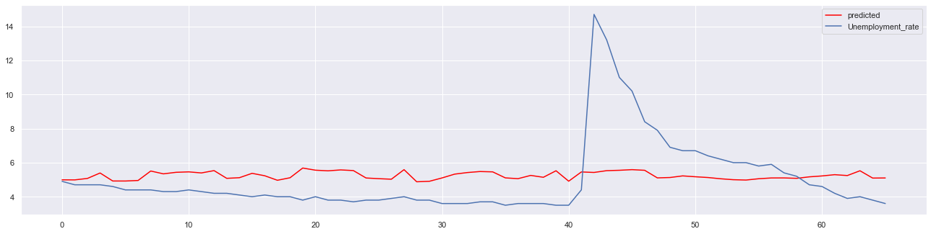
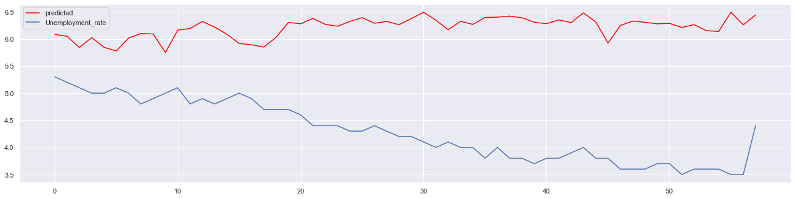
Findings Initial methods
R squared: 0.0169
R squared: -12.8656

Slide 5
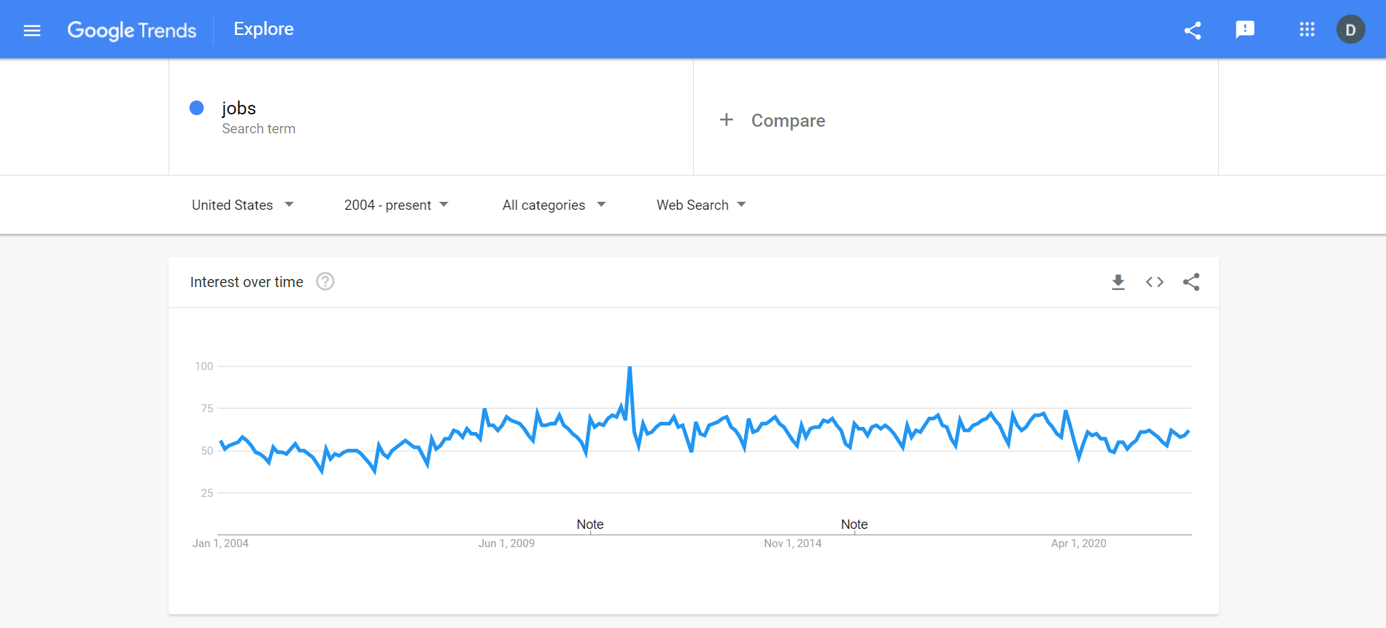
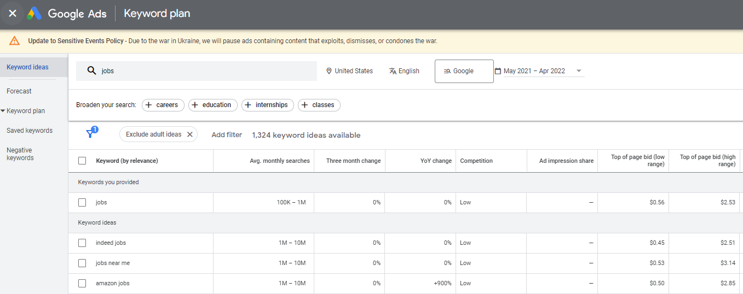

Slide 6
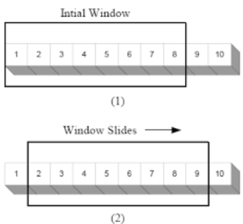
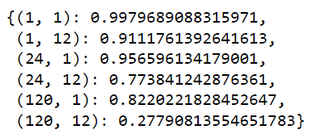
Refined Methods
Using sliding window with two variables:
number of previous months to train the model
number of months delayed to test the model
Example:

Slide 7
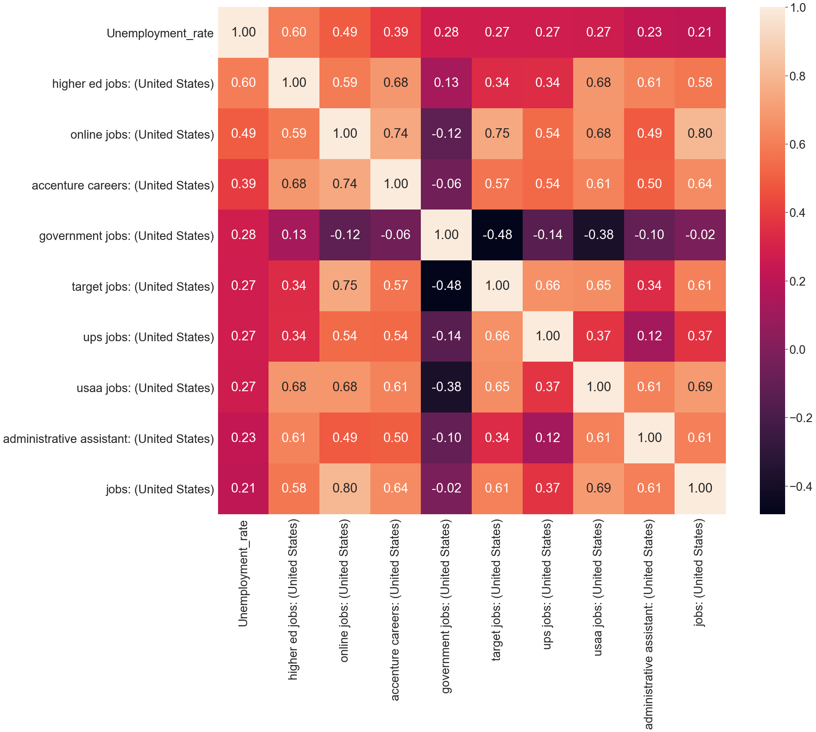
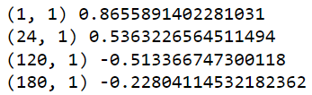
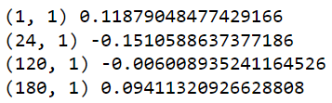
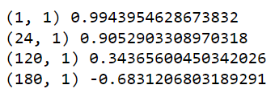
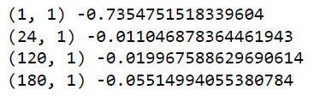
Findings Single Feature Predictions
Unemployment rate CPI:
GDP: S&P500 return:

Slide 8
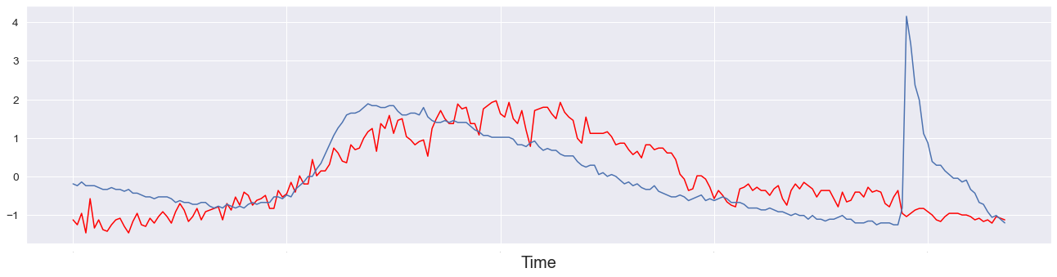
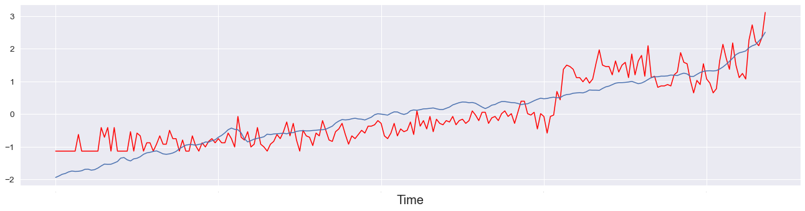
Findings Single Feature Predictions
Unemployment rate:
Y-axis is standardized, thus no label
CPI:

Slide 9
Findings Set of Features Predictions
Benchmark: using last month’s data for prediction of this month.
Example: CPI
Use different target variables
Growth rate (for S&P 500 it is already growth rate)
Volatility: absolute value of the growth rate
The random forest models consistently outperformed gradient boosting models
Linear regression models and elastic net models performed poorly as well

Slide 10
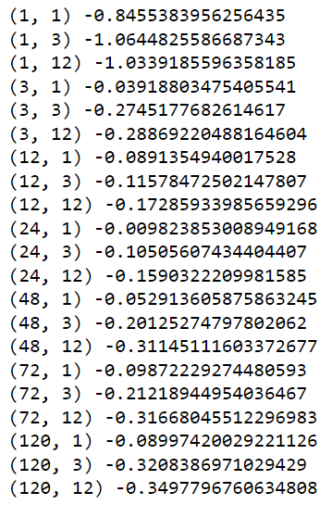
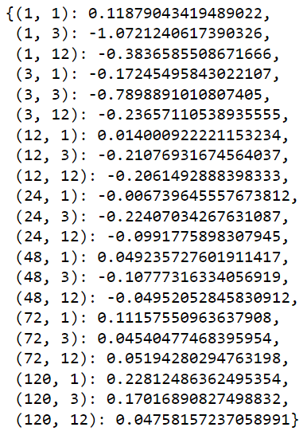
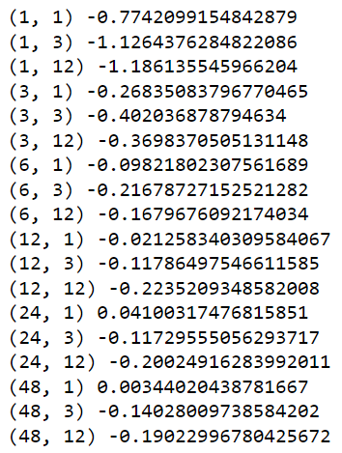
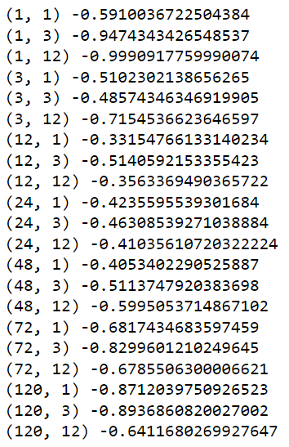
Findings Set of Features Predictions: Growth Rate
Unemployment rate CPI: GDP: S&P500 return:

Slide 11
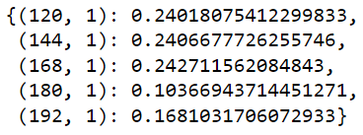
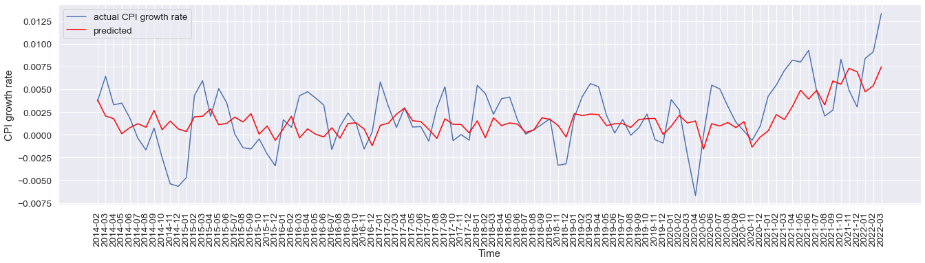
Findings Set of Features Predictions: Growth Rate
CPI growth rate

Slide 12
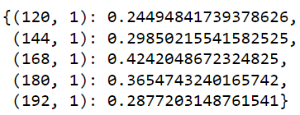
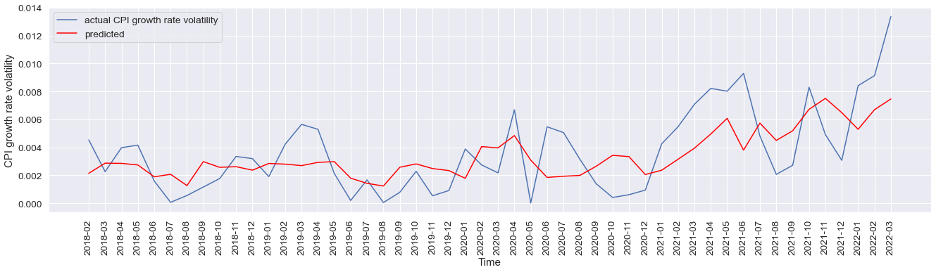
Findings Set of Features Predictions: Volatility
CPI volatility

Slide 13
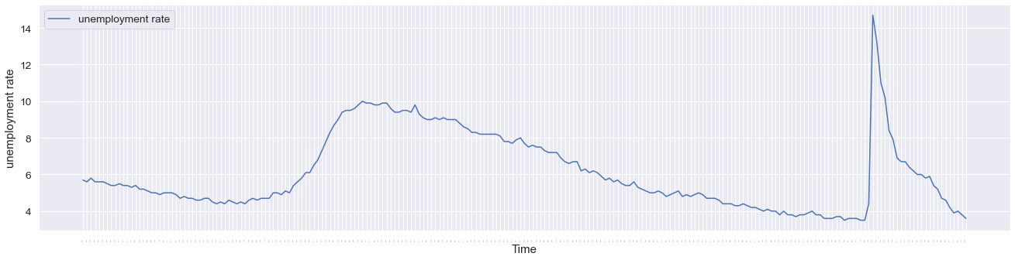
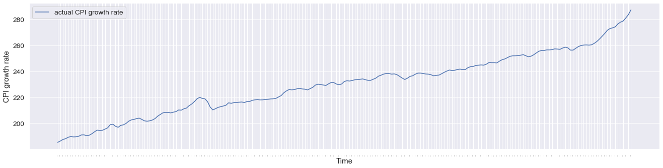
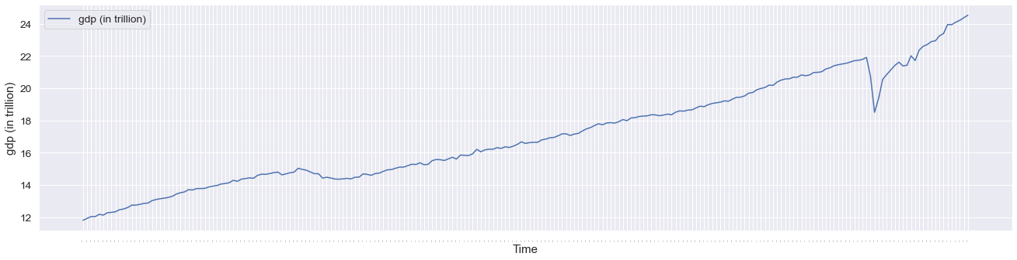
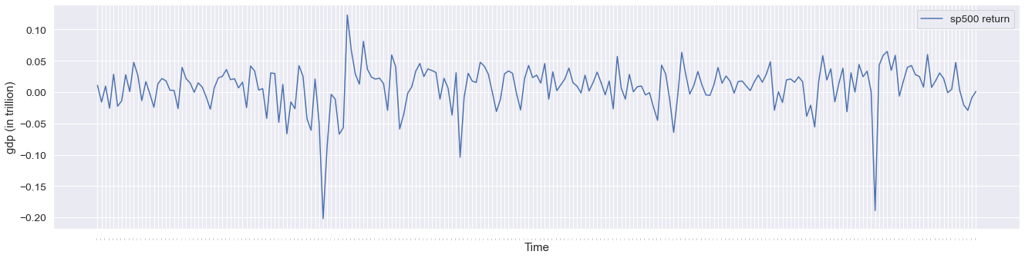
Why CPI data had better results
Unemployment rate
CPI
GDP
S&P 500 Return

Slide 14
Discussions and Future Research
The performance of the models for unemployment rate growth rate, GDP growth rate, and S&P 500 return are not very satisfactory.
The performance of models for CPI growth rate is somewhat satisfactory
Limitations
The keyword pool is limited
Selection of keyword can be changed, I relied on Google Keyword Planner
Try more sophisticated models such as deep learning

Slide 15
Discussions and Future Research
Limitations of Google Trends
Predictions for other country’s economic metrics might not be as effective especially in countries where Google is not the dominant search engine
Hard to grasp the true intent and sentiment of the searchers, partially the reason why I added volatility as a target variable
Earlier timeframes tend to have scarce number of data points
Future research
Predictions for other metrics such as sale number, which I suspect has a higher correlation with Google Trends data
Region by region predictions
Comparing predictive power of Google Trends and other tools such as Twitter and Reddit sentiments

Slide 16
References
Borup, D., & Schütte, E. C. (2020). In search of a job: Forecasting employment growth using google trends. SSRN Electronic Journal. https://doi.org/10.2139/ssrn.3423124
Byrkjeland, A. B., & Liset, M. (2020, June). Predicting stock returns using google trends. NTNU Open. Retrieved April 10, 2022, from https://ntnuopen.ntnu.no/ntnu-xmlui/handle/11250/2776948
Nagao, S., Takeda, F., & Tanaka, R. (2019). Nowcasting of the U.S. unemployment rate using google trends. Finance Research Letters, 30, 103–109. https://doi.org/10.1016/j.frl.2019.04.005
Preis, T., Moat, H. S., & Stanley, H. E. (2013). Quantifying trading behavior in financial markets using google trends. Scientific Reports, 3(1). https://doi.org/10.1038/srep01684
Wijnhoven, F., & Plant, O. (2017, December 10). Sentiment analysis and Google Trends data for predicting Car Sales. Retrieved April 7, 2022, from https://research.utwente.nl/files/232242047/Wijnhoven2017sentiment.pdf

